Slide 1
Estimation Of Business Project
Performance &Final Submission Phase

Slide 2
Project Documentations(Include Process, Design, Schedule&Report..Etc..:
Project documentation consists of a collection of documents that the project manager creates during the project's development process. The project team is expected to follow certain procedures, specifications, and guidelines for such documents, including a project plan, schedule, and budget.

Slide 3
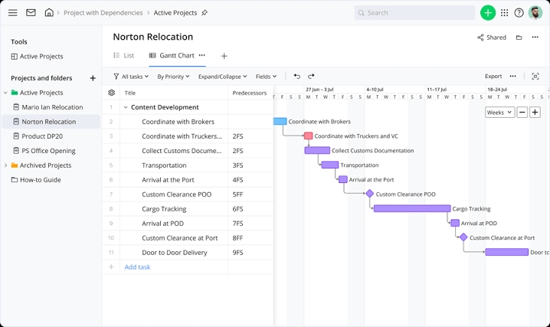
Schedule:

Slide 4
Product Documentation:
An estimate is a document that you give to a customer, showing how much you expect to charge them for goods or services you're going to supply. If you give an estimate to a customer, you're still allowed to charge them more (or less) on the invoice when you actually come to supply the goods or services.

Slide 5
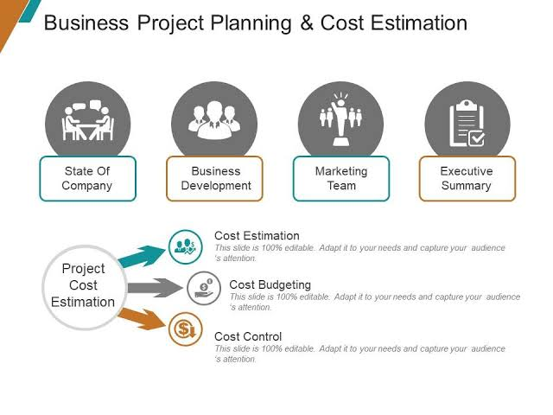
Project Demo Planning:

Slide 6
Communication:
The best way to provide the estimate is actually as a table, showing the probability that the project we'll finish on a time interval. As the time interval narrows, the probability is decreasing, as are less sure the project will be completed in that time frame.

Slide 7
Demonstration of Proposed Feature:
Project estimation is the process of forecasting the time, cost, and resources needed to deliver a project. It typically happens during project initiation and/or planning and takes the project's scope, deadlines, and potential risks into account.

Slide 8
Team Involvement In Demonstration:
Identify the effort required to complete each activity. Identify the resource estimate to complete each task or activity. Identify the dependencies to complete each activity. Identify the possible risks and assumptions.

Slide 9
Scalability & Future plan:
Scalability, whether in a financial context or within the context of business strategy, refers to an organization's ability to grow without being hampered by its structure or available resources when faced with increased production.

